Slide 1
The driest run

Slide 2
The Problem
The Idea
The Goal

Slide 3
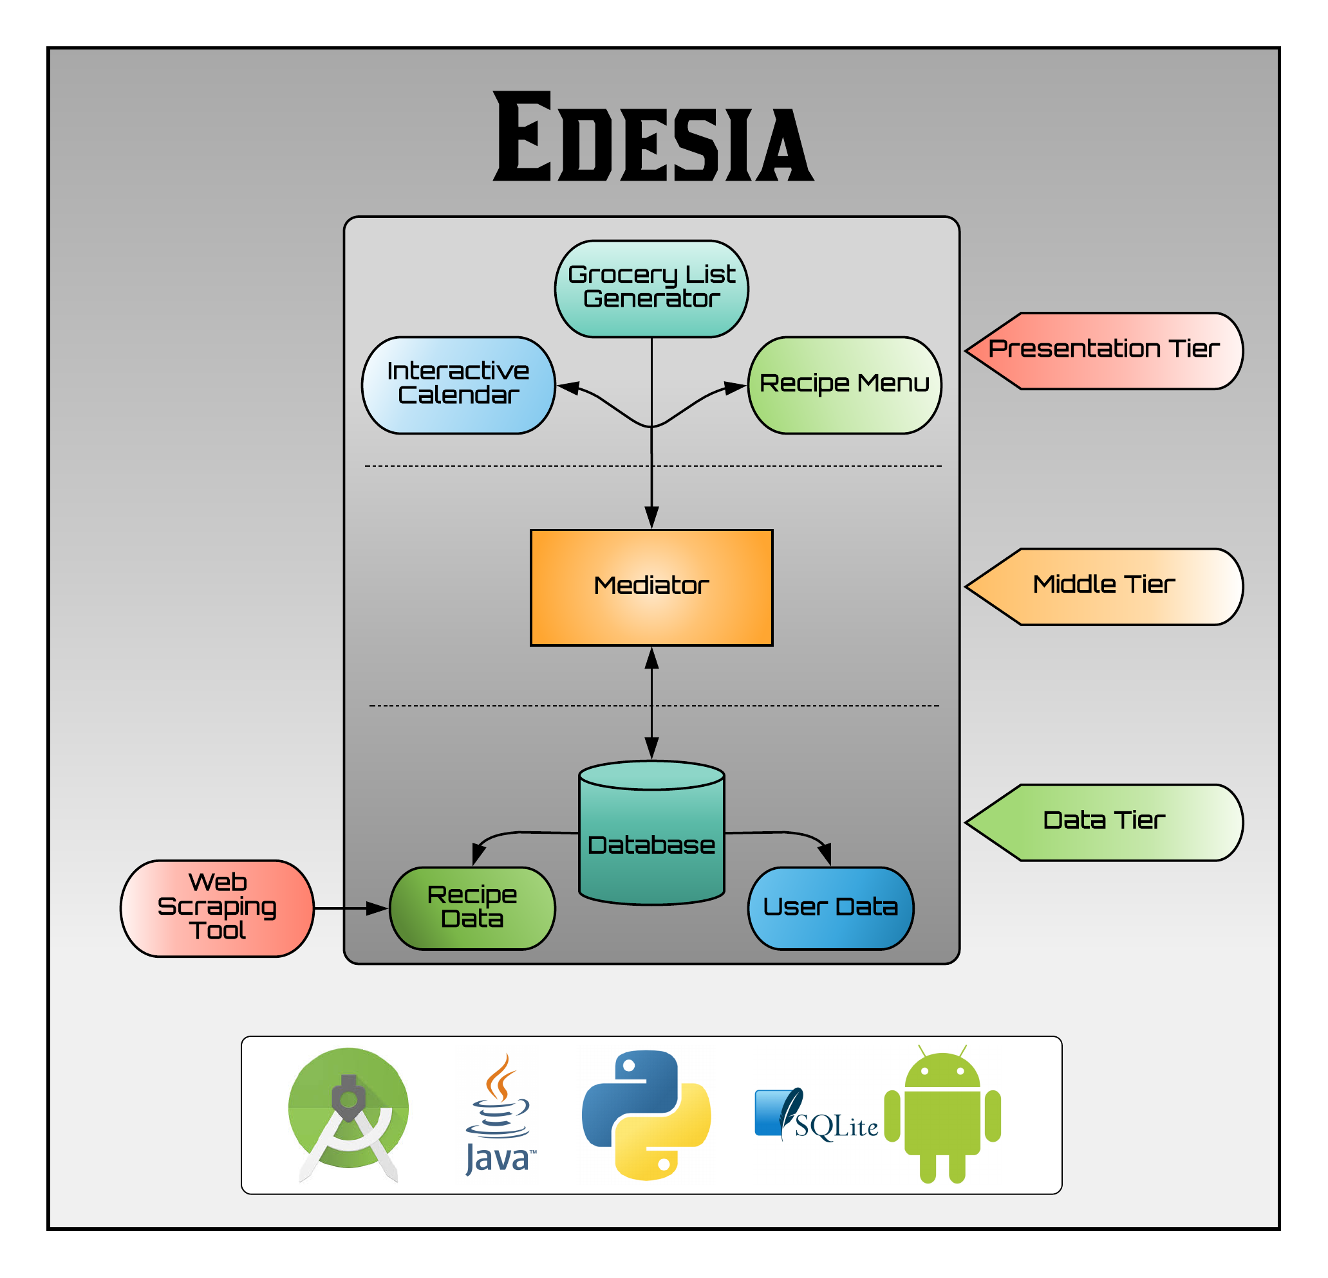

Slide 4
Calendar Subsystem
Problem - Allow the user to pick meals for a specific date and time.
Solutions -
After picking a recipe in the recipe search menu the user has the option to pick a date and time in order to plan a meal.
The user can select a date from the Meal Randomizer menu and the date will be populated three random meals.

Slide 5
User Subsystem

Slide 6
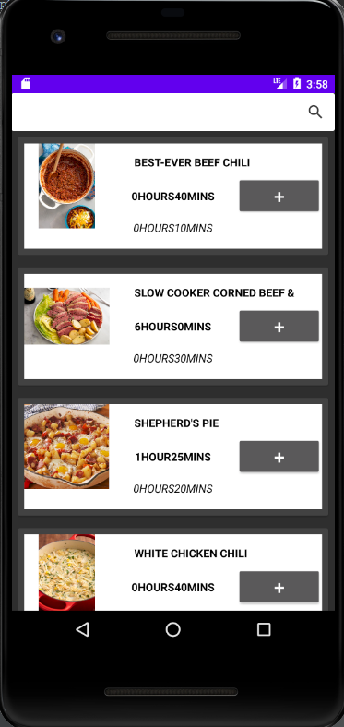
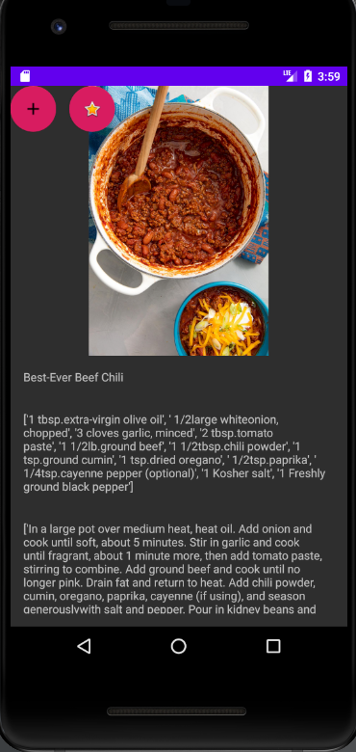

Recipe Subsystem
This Recipe subsystem solves the problem of capturing, searching and presenting data for each recipe.
The capturing utilizes python web scraper to get information on the recipes data
That data is store with in an SQLite database
The recipe search allows the user to search through the recipes and filter by keywords.
There is a recipe steps page that shows the recipes in more detail

Slide 7
Grocery List Subsystem
GLIST
OCR
???
Profit

